Slide 1


Canada Emergency Wage Subsidy
An Analysis
Bohan Gao
Eric Baxter
Vicens Paneque
CEWS Analysis | June 2021
01
Notes:
Good morning everyone. Thank you for attending, and welcome to our final capstone presentation. Today we will be discussing our work analyzing the Canada Emergency Wage Subsidy program.

Slide 2
Part 1: Report
Outline
Part 2: Dashboard
Canada Emergency Wage Subsidy
Part 3: Analysis with APIs
Team
Motivation and Purpose
Partner
Tools
Introduction
Methodology and Techniques
Background
Analysis and Interpretation
Data Sources
Conclusions and Future Work
CEWS Analysis | June 2021
02
Notes:
In the next few minutes, we will introduce ourselves and our partner and we will provide an overview of the Canada Emergency Wage Subsidy, our data sources and wrangling we made for our analysis.
Our project is divided into three parts. In the first part we explore the impact of the program through a report focused on developing insights into the effects of the subsidy on rural Canada. The second part is an interactive dashboard to explore the database we used. And the last part is a sentiment analysis using application-programming interfaces, or APIs for short, to provide social analytics on the public opinion of the program.
For each component, we will also review the motivation and purpose, the details of the tools, methodologies and techniques used. We will present some of our main findings and analysis and we will conclude with our results and future directions for our work.

Slide 3



Team
Bohan Gao
Eric Baxter
Vicens Paneque
MDS | UBCO (2021)
B.Sc. Computer Science | UBCO (2020)
MDS | UBCO (2021)
B.Sc. Mathematics | University of Ottawa (2020)
B.Sc. Psychology | University of Ottawa (2018)
MDS | UBCO (2021)
MBA | EGADE Business School (2017)
B.A. Financial Management | Tec de Monterrey (2010)
CEWS Analysis | June 2021
03

Slide 4
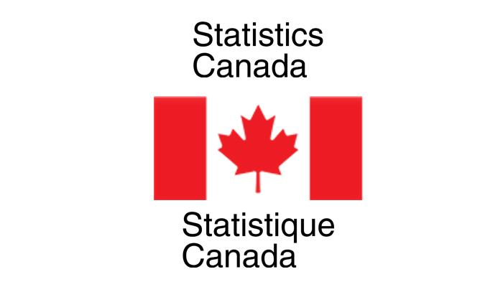
Partner
Statistics Canada
Centre for Special Business Projects
CEWS Analysis | June 2021
04
Notes:
We collaborated with Statistics Canada Centre for Special Business Projects and would like to acknowledge and thank Scott Bacon, our primary contact, Haaris Jafri, (Ash Munro, Nick Newstead and Mahamat Hamit-Haggar) for their support and guidance throughout this project.
Optional: Statistics Canada or StatCan for short, is Canada’s national statistics office. The agency produces relevant, accurate and timely data that help Canadians better understand their country, to function effectively as citizens and decisions makers.
The Centre for Special Business Projects within StatCan covers a wide range of topics, which include business performance and trends, economic impact studies, new measurement frameworks and indicators to support program development, territorial economic indicators and other special studies.

Slide 5
Introduction
Health Crisis
COVID-19
Economic Hardship
Temporary Wage Subsidies
Lockdown
CEWS Analysis | June 2021
05
Notes:
The consequences of the COVID-19 health pandemic for many have been unexpected and devastating. Initially, as the virus spread; many countries went into lockdown to protect the health of their populations.
As part of a wider range of policy measures to counteract the economic and labour market effects of the crisis, many countries implemented temporary wage subsidies.
While targeted subsidies seek to encourage firms to employ specific categories of workers, temporary wage subsidies are used in times of crisis to save jobs and help businesses keep as many employees as possible on the payroll. During the COVID-19 crisis, wage subsidies have been implemented to maintain the employment relationship during the lockdown and were later extended to prevent layoffs during the economic downturn that followed the end of the lockdown.

Slide 6
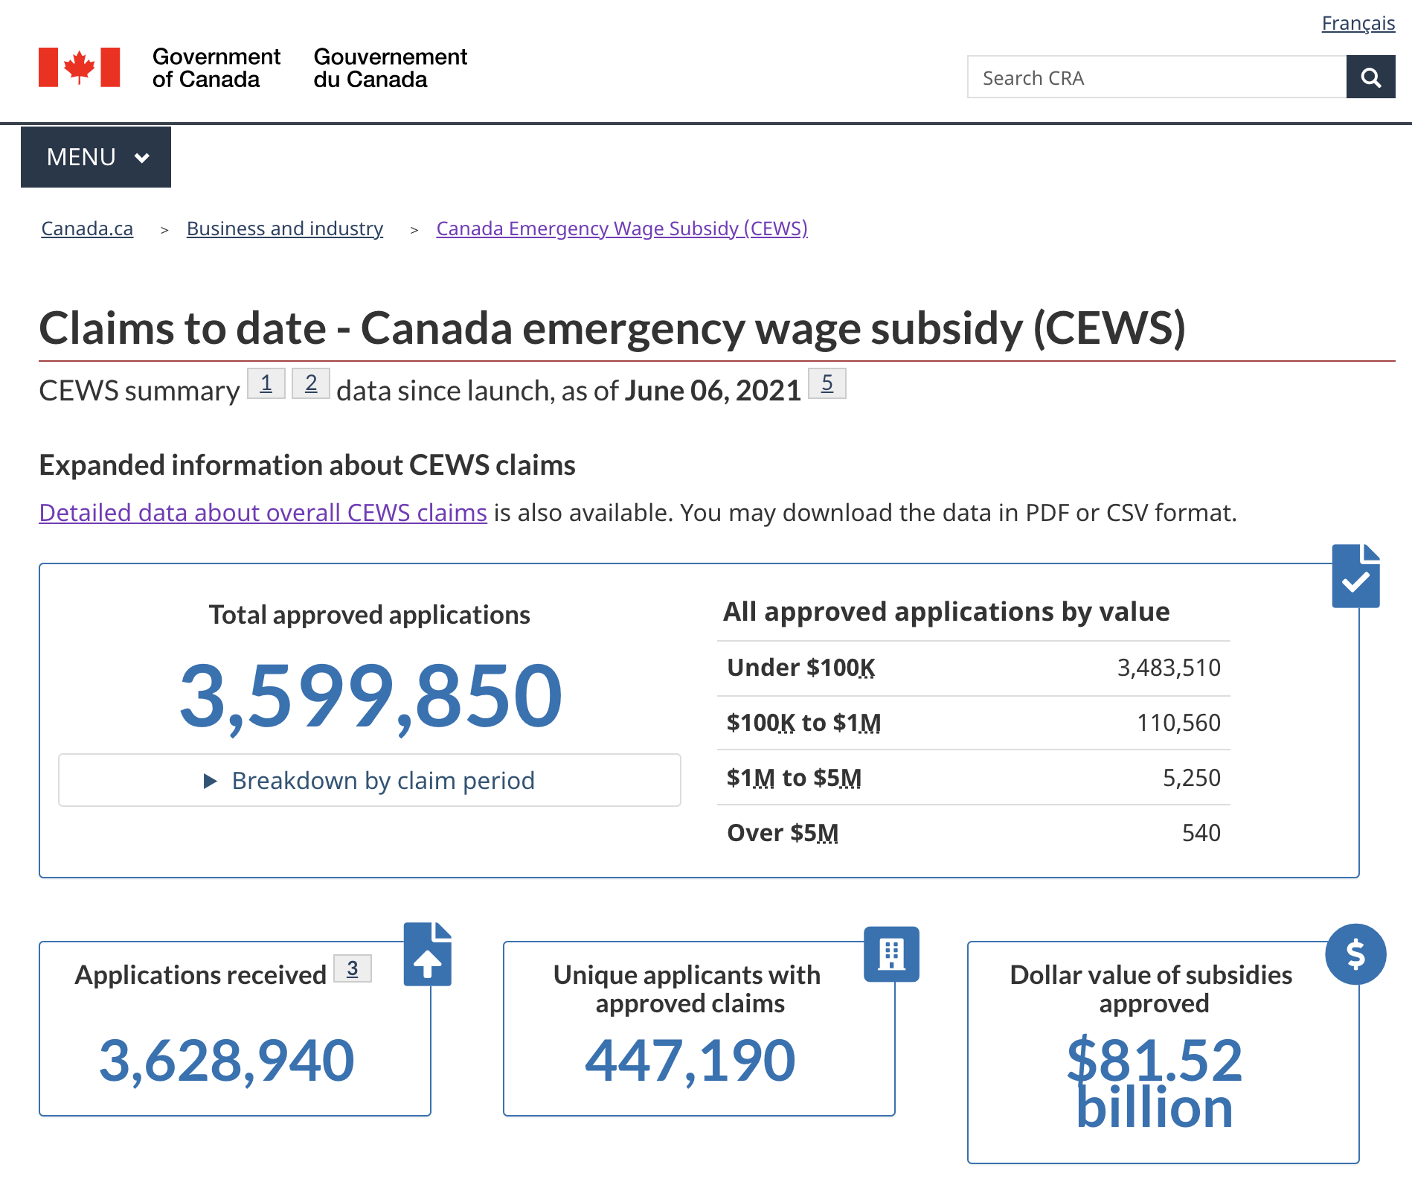
Background
Canada’s COVID-19
Economic Response Plan
Canada Revenue Agency
CEWS Analysis | June 2021
Source: Government of Canada
06
Notes:
In Canada, the government implemented temporary restrictions on non-essential businesses, school closures and physical and social distancing policies to mitigate the spread of the virus. However, these policies also resulted in job losses and lower employment income.
To alleviate the economic impact of the pandemic, the government implemented a range of financial and monetary measures through Canada’s COVID-19 Economic Response Plan.
Within the Plan, the government introduced the Canada Emergency Wage Subsidy, or CEWS for short, to help businesses keep and rehire employees during periods of reduced income, and facilitating return to normal operations. The program is administered by the Canada Revenue Agency.
Beginning March 15, 2020, CEWS offers a wage subsidy of seventy-five per cent, up to eight-hundred-forty-seven dollars per week per employee, to qualifying employers. CEWS is broken down into 4-week periods with different calculation details and qualifying criteria. When first launched, the program was intended to last 12 weeks, however, the Government of Canada has kept it until June 30, and proposed to extend the program until September 25 in its Budget 2021.
To date, CEWS has provided over 80 billion dollars in subsidies in more than three and half million applications.

Slide 7
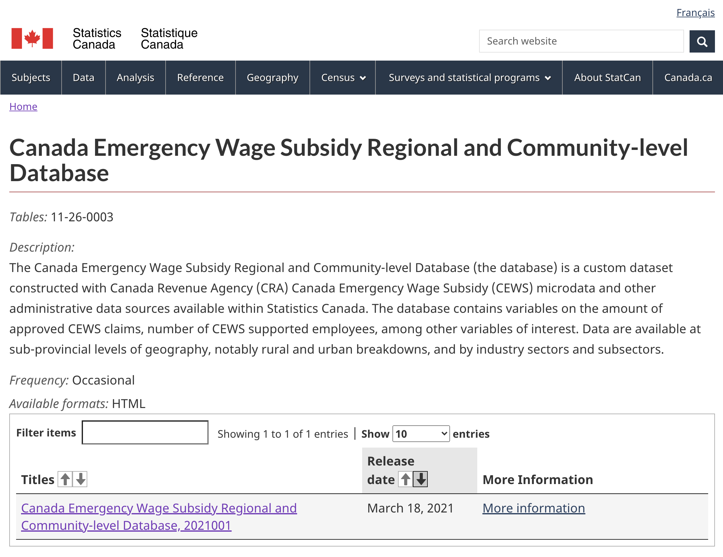
Data Sources
CEWS Analysis | June 2021
Source: Statistics Canada
07
Notes:
The main data source we used for our project is the CEWS Regional and Community-Level Database, which is publicly available at the Statistics Canada website.
This dataset provides data on the CEWS program during the first 8 “claim periods”, which covers March 15 through October 24 2020.

Slide 8
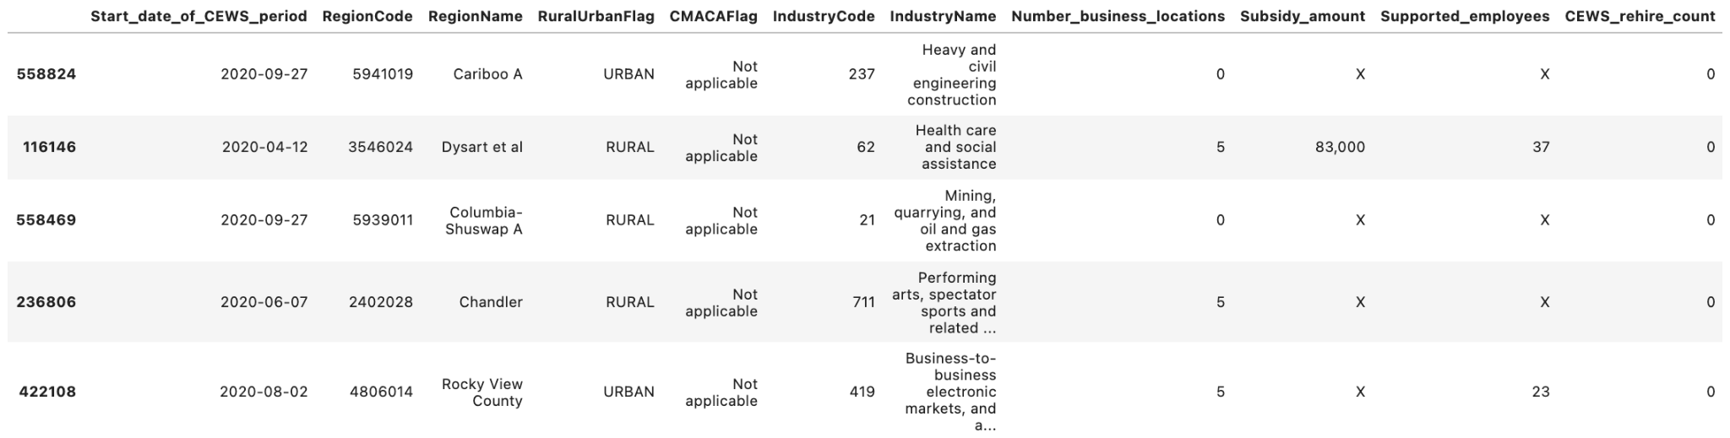
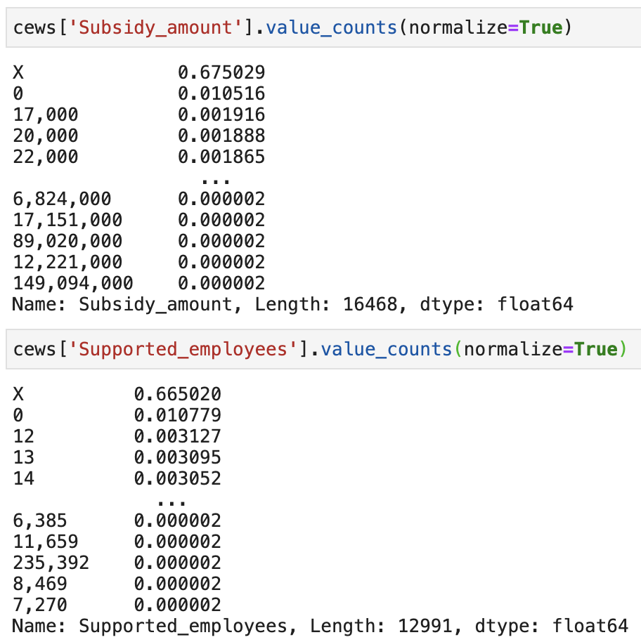
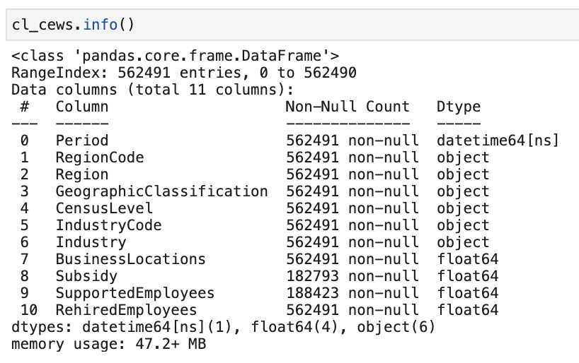
Data Sources
2016 Standard Geographic Classification
1-digit: Canada
2-digit: Provinces and Territories
5-digit: Census Agglomeration or Census Metropolitan Areas
7-digit: Census Subdivision
North American Industry Classification System
All industries
2-digit: Industry sector
3-digit: Industry subsector
CEWS Analysis | June 2021
08
Notes:
The CEWS dataset consists of eleven columns and about half a million rows. It has four dependent variables, number_business_locations, subsidy_amount, supported_employees, and cews_rehire_count.
The dataset is organized hierarchically, both with regard to geography and industry. The “RegionCode” column gives a unique 1 to 7 digit code corresponding to the geographic region. The “IndustryCode” column gives a 1 to 3 digit code which uniquely gives the industry.
These codes are defined via the 2016 Standard Geographic Classification System (SGC-2016), and the North American Industry Classification System (NAICS).
Both systems are hierarchical, with more digits corresponding to more granular regions or industries. A 2 digit SGC-2016 code corresponds to a province or territory, a 5-digit code corresponds to a census agglomeration or census metropolitan area, and a 7-digit code corresponds to a census subdivision.
A 2-digit NAICS code corresponds to an industry sector, while a 3 digit code corresponds to a more granular industry subsector.
There is also a column which defines the region as either “urban” or “rural”, where a rural area is defined as any place not within a census agglomeration or census metropolitan area.
Data suppression was implemented on the dataset to ensure it meets Statistics Canada's confidentiality requirements. Subsidy values were suppressed if there was potential for someone to “reverse engineer” the data and accurately guess at which company a subsidy went to. In practice, this means that much of the more granular data has been suppressed, especially for rows corresponding to industry subsectors within small census subdivisions. In total, about 67% of the subsidy amount and supported employees values have been suppressed.

Slide 9
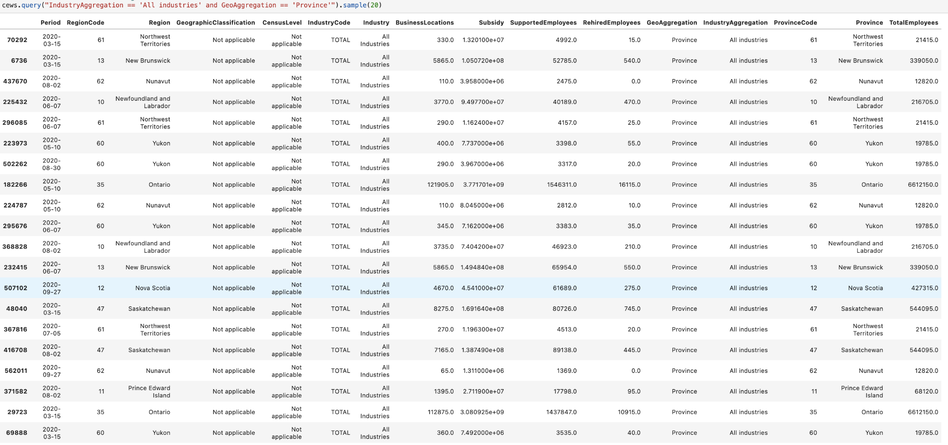
Data Wrangling
Typical Wrangling
Change null ‘X’ to np.nan
Alter data types
Rename columns and factor levels
Hierarchical Solution
Develop queryable “subsetting columns”
Data Augmentation
Province name column with regex
Worker count data through merging additional datasets
CEWS Analysis | June 2021
09
Notes:
We had to do a bit of work to wrangle the raw CEWS data into a format that was useable for our analyses.
First, we had to do some basic wrangling. Null values were represented as “X” in the CEWS data, which we had to replace with NumPy’s null data type in order to convert those columns to numeric types. We also renamed some of the columns and factor levels to be shorter and more “Pythonic”.
We had to work around the hierarchical structure of the dataset to ensure we would only count subsidies once in any analysis. We did this by using regex to develop two “aggregation level” indicator columns. By querying for a specific level of each of these, we ensured that only data from single levels of the industry and geography hierarchies were included, preventing multi-counting of subsidies. In the example on screen, we are querying the dataset to only show rows corresponding to aggregation to the levels of “province” and “all industries”.
Finally, we augmented our data set with a couple more useful columns. Using Regex, we created a column describing the province each region is contained in. Then, using other open data sets developed from the 2016 census, we augmented our data with information on the number of workers employed within given regions and industries. This allowed for normalized comparisons between regions and industries of varying size.

Slide 10

Part 1:
CEWS Report
CEWS Analysis | June 2021
10
Notes:
Now, I would like to discuss some of our findings from our exploratory CEWS report.

Slide 11
Motivation and Purpose
1
CEWS Report
Examine the data across all available dimensions. Report on interesting trends, especially within rural Canada.
Insights into the effects of the program on rural Canada
CEWS Analysis | June 2021
11
Notes:
The primary goal of the CEWS report was to explore the CEWS Regional and Community-level database across all available dimensions and report on interesting trends, especially within rural Canada.

Slide 12



Tools
Programming Language
Python
Data Structures and Wrangling
Pandas, NumPy and RE
Data Visualization
Altair and Matplotlib
CEWS Analysis | June 2021
12
Notes:
Data wrangling, exploration and visualization were done in Python.
We imported Pandas, Numpy and RE packages for data structures and wrangling, and Altair and Matplotlib for visualizations.

Slide 13
Sample Analysis
Overview
1
What are the high level trends?
2
Most Subsidized Rural Census Subdivisions
How much did they receive, and where are they located?
3
Industry Breakdown
Why did these CSDs need so much subsidy money? Which industries did the money go to?
CEWS Analysis | June 2021
13
Notes:
While we do not have time to cover all of the findings in our report, I would like to go over a small sample from our analysis by examining high level trends, heavily subsidized rural Census subdivisions, and the industry breakdown of subsidies within those regions.

Slide 14
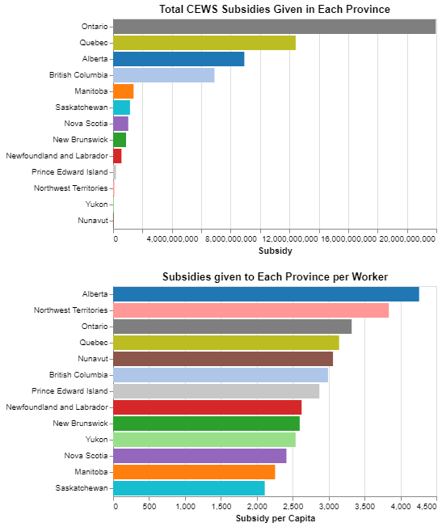
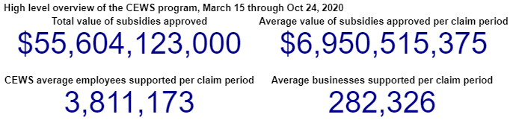
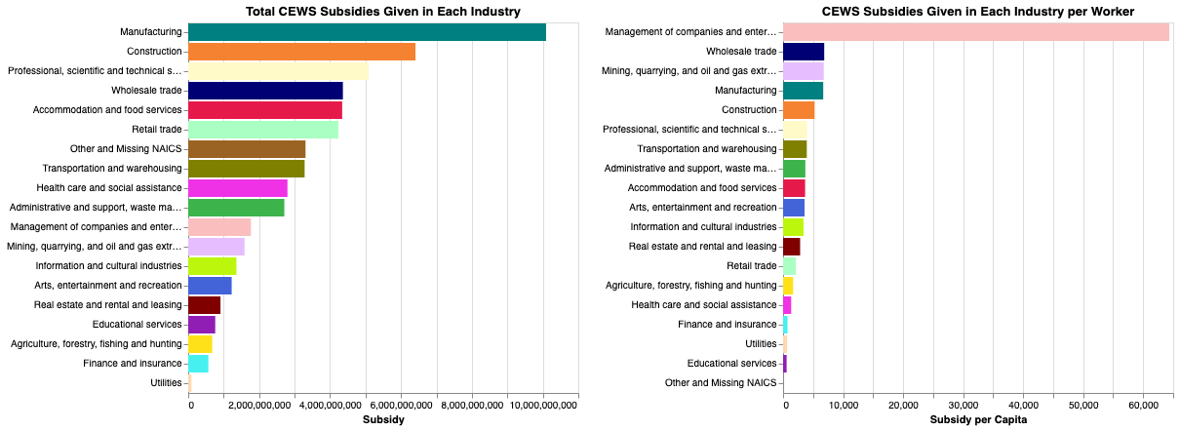
Analysis and Interpretation
CEWS Analysis | June 2021
14
Notes:
First, we see our high level trends. This dataset covers $55 billion of CEWS subsidies given between March 15 and October 24. The average number of supported employees per claim period was 3.8 million, and the average number of supported businesses per claim period was 280 thousand.
We see in the bottom left graph the total unsuppressed subsidies given within each industry throughout Canada.
The top right graph shows the total subsidies given within each province, and the bottom right shows the amount given per-worker in each province.
The most interesting finding here is that Alberta received the most subsidies per-capita, while the other Prairie provinces received the least, Manitoba and Saskatchewan.

Slide 15
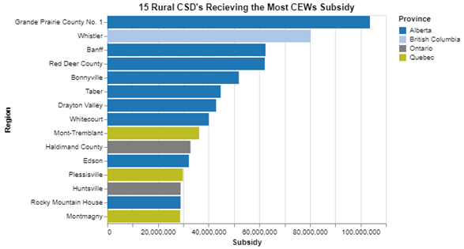
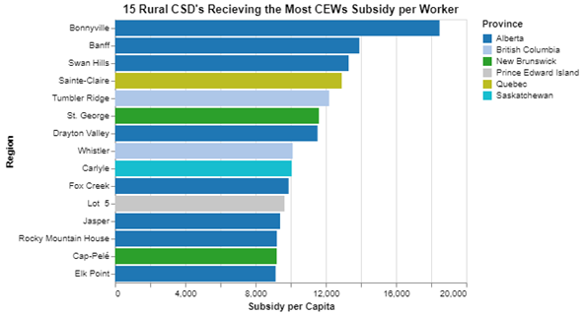
Analysis and Interpretation
CEWS Analysis | June 2021
15
Notes:
Next, we visualized the 15 rural census subdivisions which received the most subsidy money, both in total on the left, and per-capita on the right.
We see here that Alberta is heavily represented in both these graphs, with 9 of 15 on the left graph within Alberta, and 8 of 15 on the right graph within Alberta.

Slide 16
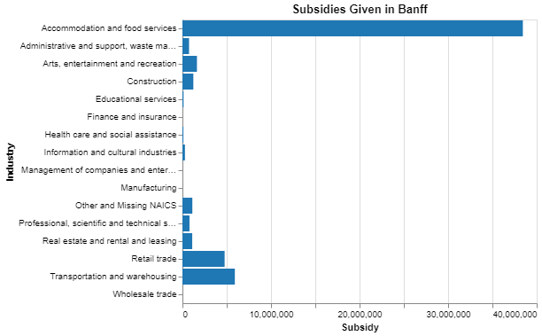
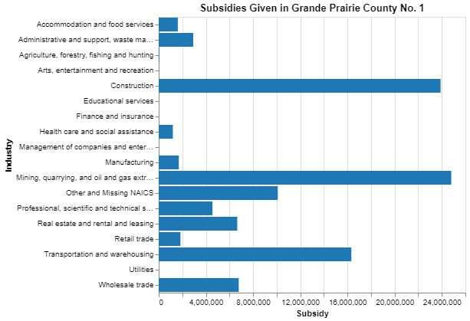
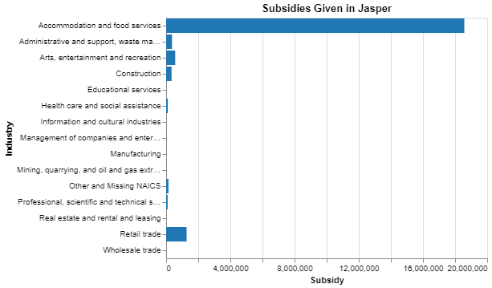
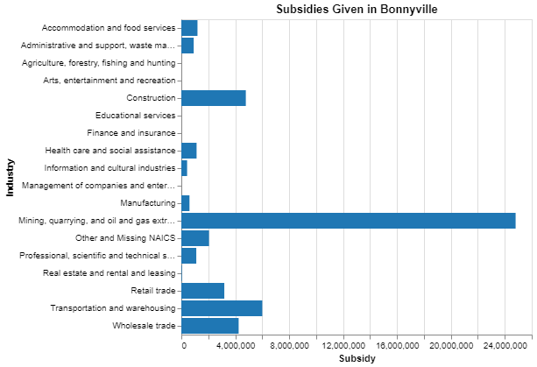
Analysis and Interpretation
CEWS Analysis | June 2021
16
Notes:
In order to figure out why so many places in rural Alberta required large subsidies, we looked at the industry breakdown for each of the Albertan census subdivisions in the previous graph.
Here we have included graphs of four of these regions. The two graphs to the left show Banff and Jasper. Both of these towns are heavily dependent on tourism and received the majority of their CEWS subsidies in the accommodation and food service industry.
The two graphs on the right show Grande Prairie and Bonnyville, which are heavily dependent on oil and gas, and received their largest subsidies in the mining, quarrying, and oil and gas extraction industry.
This trend was true for all 13 of the Albertan census subdivisions that appeared on the previous page. They were either tourist towns which were severely affected by social distancing and travel restrictions, or they were oil towns which required a lot of subsidy money due to the importance and low profit margins of the Alberta oil industry.

Slide 17

Part 2:
CEWS Dashboard
CEWS Analysis | June 2021
17
Notes:
A data dashboard based on the CEWS dataset is the 2nd part of our project.

Slide 18
Motivation and Purpose
1
CEWS Report
Insights into the effects of the program on rural Canada
Allow user to visually explore the CEWS database
2
CEWS Dashboard
Tool for database exploration
CEWS Analysis | June 2021
18
Notes:
Further to our CEWS report, we also developed an interactive visualization dashboard.
While data on the CEWS program is publicly available on the StatCan website, there are currently limited analyses and no interactive visualization tools available to help the general public better understand the data.
This dashboard includes several tools for exploring all dimensions of the CEWS Regional and Community-level database.

Slide 19
Tools
Dashboard
Microsoft PowerBI
Interactive Maps
ArcGIS and ShapeMap
CEWS Analysis | June 2021
19
Notes:
The interactive dashboard was created using Microsoft PowerBI version 2.93.384.0. The interactive maps in the dashboard were made using ArcGIS and ShapeMap. We considered using alternative, programming-based dashboard tools, but PowerBI allowed for easier integration into the Statistics Canada website.

Slide 20
Methodologies and Techniques
1
Interactive Visualizations
Base PowerBI and ArcGIS Extensions
2
Deployment
PowerBI website
CEWS Analysis | June 2021
20
Notes:
Using the same wrangled dataset created for the CEWS report, and using ArcGIS extensions and Shape Map tool for PowerBI we developed interactive heat maps, allowing users to visually explore the distribution of CEWS subsidies throughout Canada, at varying levels of geographic aggregation.
We deployed all pages online using the PowerBI website.

Slide 21
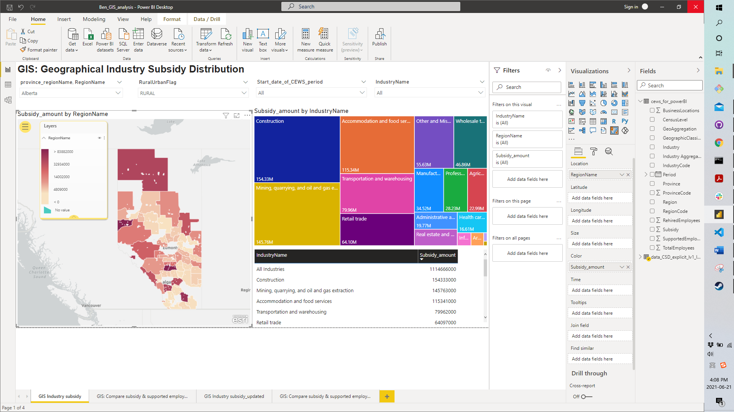
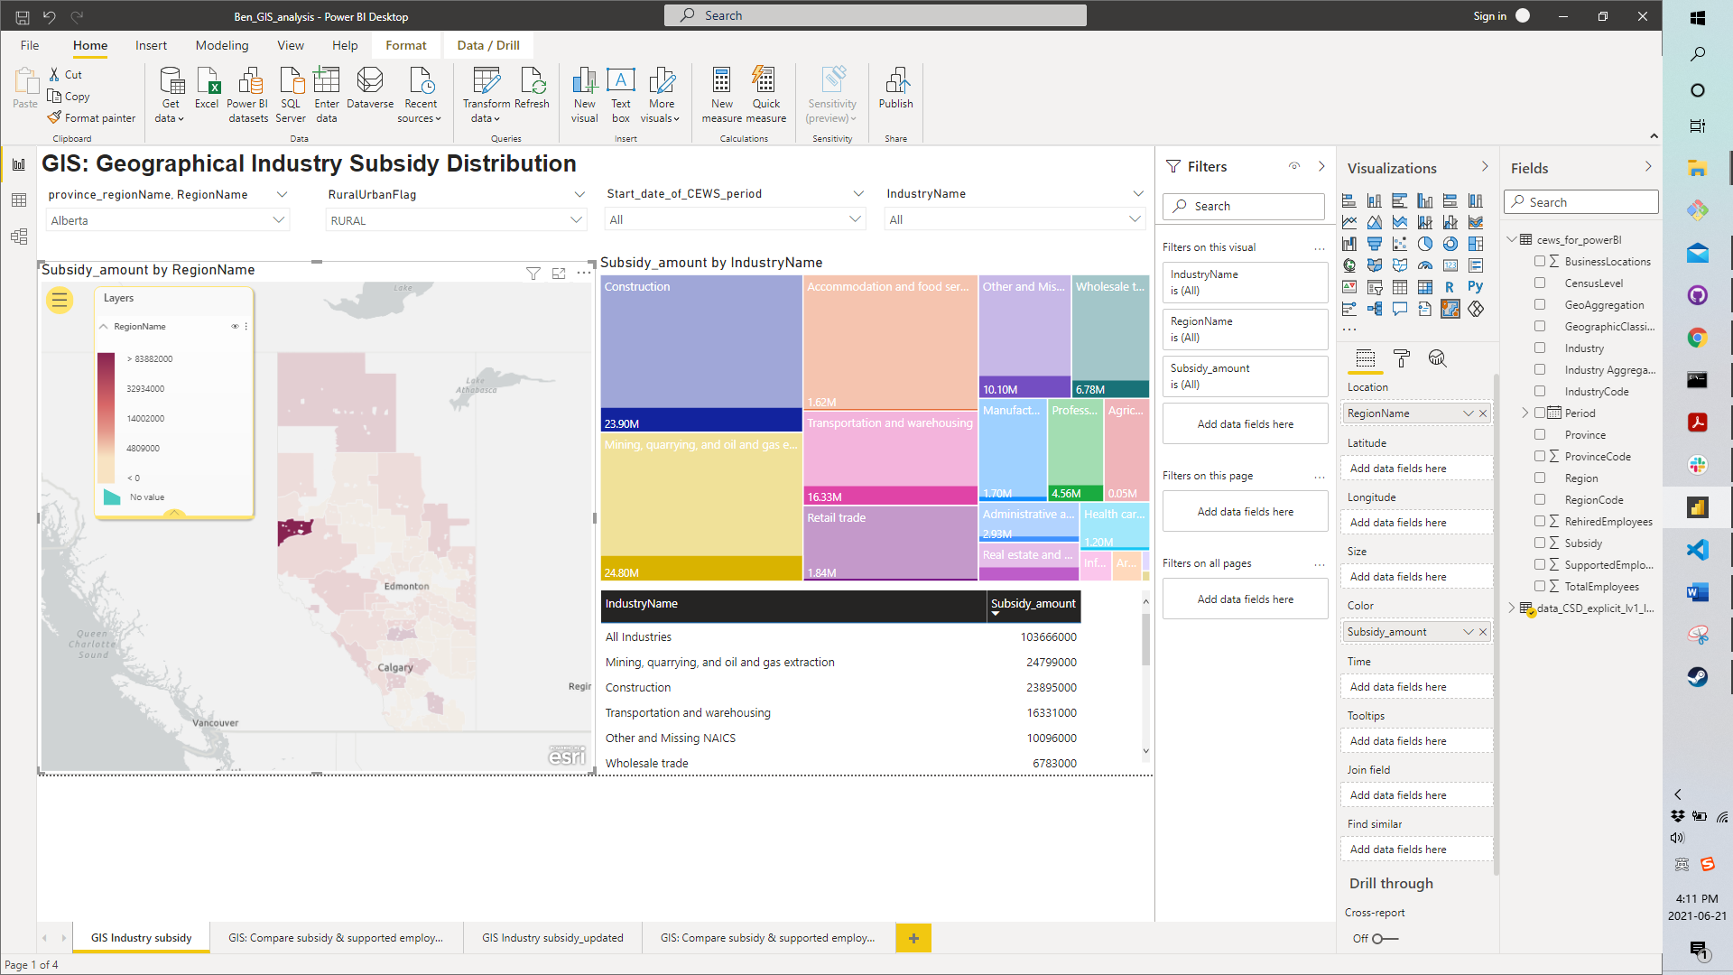
Analysis and Interpretation
CEWS Analysis | June 2021
21
Notes:
***NOTE: SHOW DASHBOARD***
The first dashboard that I would like to introduce is the one that demonstrates subsidy distribution among the census subdivision regions.
In our CEWS data report, we already learned that in the rural regions of alberta, there is a place called Grande Prairie. Despite its size, it receives much more subsidy than its neighbour regions, let’s begin by locate this region in alberta on our GIS dashboard.
For doing that a user needs to select Alberta for the Province drop down, and then select rural flag. Now all rural regions of alberta are displayed on our dashboard.
On the west side of this province, we observe a small region that has much higher color intensity than its neighbours. --- Bingo! This is Grande Prairie.
Now, we are curious about what industry plays a main role that makes this small region receives much more subsidy than its neighbours.
If we click on this small region, we will see the proportions of subsidy for each industry that Grande Prairie shares in Alberta.
It is seems there is a good amount of subsidy goes into mining industry and construction industry.
Now let’s compare Grande Prairie’s subsidy distribution to the rest of the country.
and show the tree map and talk about the mining industry.

Slide 22
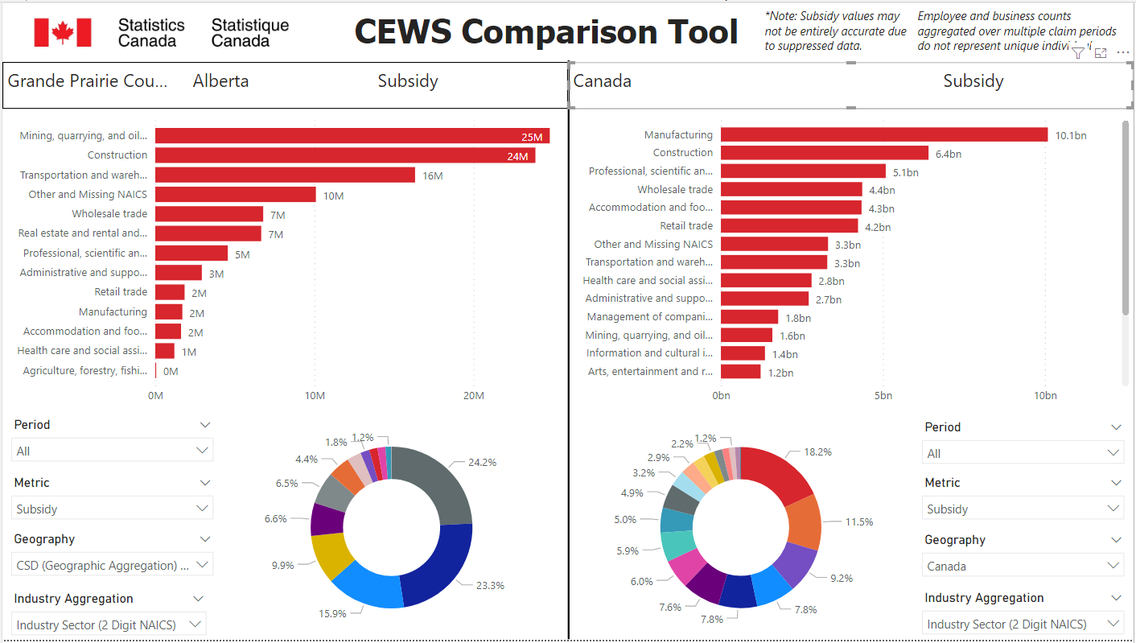
Analysis and Interpretation
CEWS Analysis | June 2021
22
Notes:
***NOTE: SHOW DASHBOARD***
This dashboard is designed for comparing data for two regions.
On the left hand, it is the industry subsidy distribution for the Grande Prairie.
On the right hand side, there is the industry subsidy distribution for the entire country.
We discover that in Grande Prairie, majority of the subsidy goes into mining and construction. At the meanwhile, for the entire country, although the construction industry also comes at the second place, the mining industry comes at the 12th place.
Therefore, we have enough evidence to conclude that it is the mining industry that makes this small region, Grande Prairie, shares more subsidy than its neighbours.

Slide 23
Other Pages
1
Overview
Canada wide numbers and Province-level heatmap
Link to dashboard in chat
2
Flexible Breakdown Tool
Split data across any dimension of interest to explore regions and industries of interest
3
Claim Period Breakdown Graphs
Compare subsidies given to regions or industries in each claim period
CEWS Analysis | June 2021
23
Notes:
We built some other pages as well which we will not talk about due to time restrictions. For anyone interested in exploring our dashboard, the links are in the chat

Slide 24

Part 3:
CEWS Analysis with APIs
CEWS Analysis | June 2021
24
Notes:
Next, we will discuss the final part of our project, which is a CEWS analysis with APIs.

Slide 25
Motivation and Purpose
1
CEWS Report
Employ data that is not available from traditional survey and administrative sources to measure economic activity and study social behavior at high-frequency and in real time
Insights into the effects of the program on rural Canada
2
CEWS Dashboard
Tool for database exploration
3
CEWS Analysis with APIs
Focus on natural language processing (NLP)
CEWS Analysis | June 2021
25
Notes:
In Canada and around the world, data and the digital economy are fueling innovation, as well as economic and social opportunities.
Through evaluations of cost, efficiency, and usefulness of data, we conducted a feasibility study to make recommendations to Statistics Canada on which APIs should be used for leveraging the digital data economy to develop new techniques to measure economic activity and study social behavior at high frequency in real time.
Furthermore, we developed preliminary software for three of the examined APIs for analyzing messages and opinions regarding topics of interest.

Slide 26
Programming Language
Tools
Python
Data Structures and Wrangling
Pandas and RE
Data Visualization
Altair and Matplotlib
API Access
Tweepy
Sentiment Analysis
String, NLTK and TextBlob
CEWS Analysis | June 2021
26
Notes:
Pandas and Re were used for data structures and wrangling.
Altair and Matplotlib were used for visualizations.
Tweepy Python wrapper was used to access Twitter.
String, NLTK (natural language toolkit) and TextBlob were used for sentiment classification.

Slide 27
Methodologies and Techniques
API Inventory
1
18 APIs researched and reported
2
API Access
Twitter API developer account
3
Data Wrangling
Removing URLs, usernames, stop-words, tokenizing and lemmatizing
4
Sentiment Analysis
Naïve Bayes analyzer and semantic relation
5
Data Visualization
Analyzing results
CEWS Analysis | June 2021
27
Notes:
We first conducted and inventory of APIs. We reported on 18 and considered 4 as feasible for our use case. One of those APIs was Twitter and we performed preliminary natural language processing and sentiment analysis using its API.
We started by getting a Twitter developer account, and to access Twitter data, we used Tweepy. Tweepy allows to get tweets by keyword or location, and language from a given date. This functionality allowed us to retrieve tweets in Canada including the word CEWS.
The next step was to clean the tweets to make them machine readable to our model. We removed URLs, usernames, and standard English stop-words from tweets with regular expressions and NLTK. We also used that package for tokenizing and lemmatizing, which is splitting words by whitespaces and breaking them to its root.
For the sentiment analysis, we used NaivesBayesAnalyzer which is a model trained on a movie reviews corpus to classify tweets as having a positive or negative sentiment. We also used TextBlob to get sentiments scores on polarity and subjectivity. The sentiments are based on semantic relations and the frequency of each word in a sentence.
Finally, we visualized our results using Altair and a word cloud visualization, where the word size indicates its frequency in a text.

Slide 28
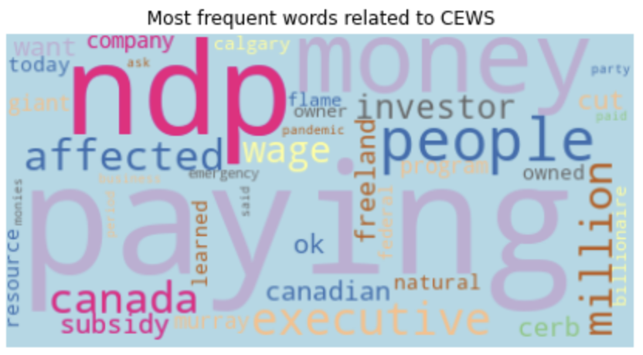
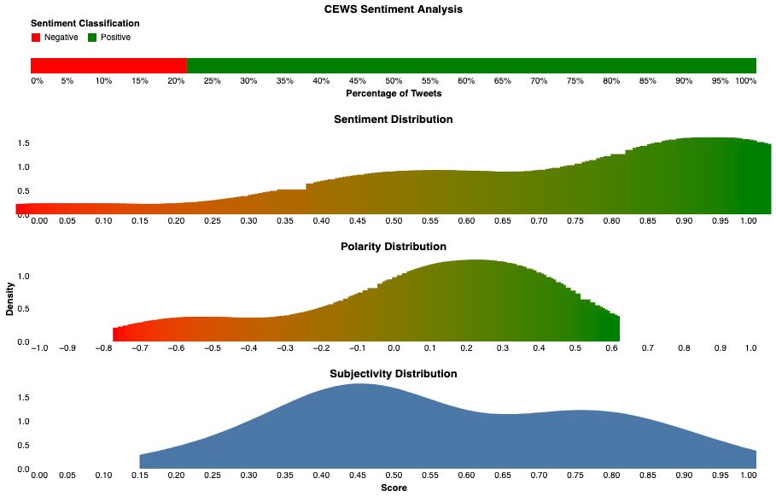
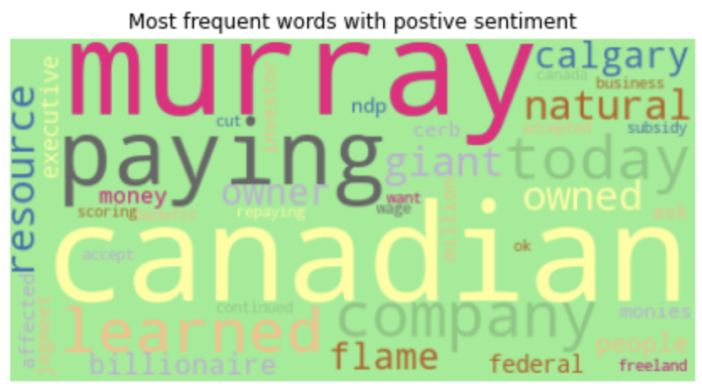
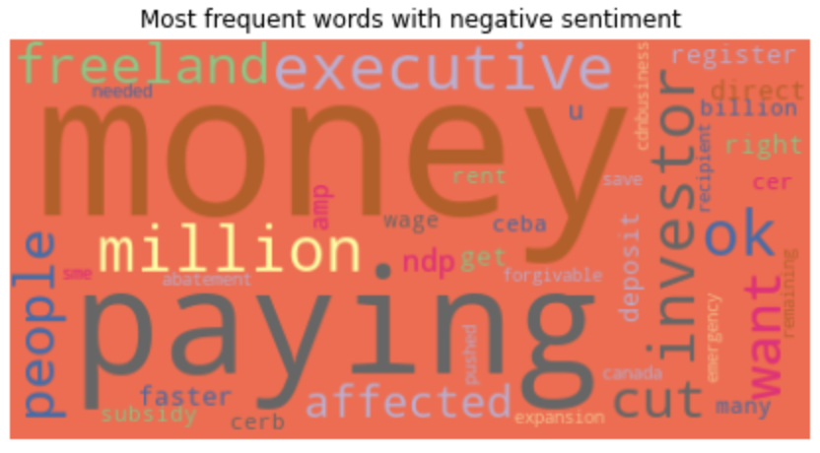
Analysis and Interpretation
CEWS Analysis | June 2021
28
Notes:
This visualization summarizes the implementation of our sentiment analysis in tweets containing the word CEWS.
We retrieved two-hundred-eighty tweets from June 11 to June 19 and were able to classify the sentiment of seventy-nine.
The top horizontal bar chart shows that 80% were classified as positive and 20% as negative.
The second row shows the sentiment distribution of those tweets. Below a score of .5 the tweet is classified as negative and above as positive.
The next chart is the polarity distribution. Polarity ranges from -1 to 1 where a negative score indicates a negative polarity, and a positive score, a positive one. The last row of distribution charts shows subjectivity scores, which ranges from 0 to 1 where 0 is objective and 1 a subjective text.
We see that the tweets we analyzed are more likely to express a subjective opinion and have a positive polarity.
The blue word cloud visualizations show the most frequent words in our tweets. The green one shows the words more associated with positive sentiment, and the red one the words more related with negative sentiment.

Slide 29
Conclusions
Report
Dashboard
API Analysis
Insights into the effects of the program on rural Canada
Interactive visualization dashboard
Inventory of APIs and demo software
Future Work:
Extend the data claim periods up until the end of the CEWS program
Source additional data
Develop indicators
CEWS Analysis | June 2021
29
Notes:
Finally, as a summary and conclusions of our project, we explored the impact of the CEWS program.
In our report, we examined the effects of geographic regions and industry on given subsidies. We focused on developing insights into the effect of the program on rural Canada and reported on some of the more interesting results.
We developed an interactive visualization dashboard to allow users to visually explore the CEWS database.
And we conducted an inventory of APIs and developed preliminary software as test cases to showcase the APIs capabilities.
Regarding future work, the next step would be to expand the findings to include data from the full duration of the CEWS program once that data is released publicly. There are also many other topics left to explore in the CEWS dataset that we could analyze.
Our dashboard could also be expanded to include data from sources other than the CEWS database.
Lastly, further work would be required to develop useful indicators to provide actionable recommendations from the data we gather and analyze through APIs.

Slide 30
Thank you!
CEWS Analysis | June 2021
30
Notes:
This the end of our presentation, thank you for listening and we are available if you have any questions.

